Slide 1
Visualizing Multi-dimensional Persistent Homology
Matthew L. Wright
in collaboration with Michael Lesnick
Institute for Mathematics and its Applications
University of Minnesota

Slide 2
What is persistent homology?
Persistent homology is an algebraic method for discerning topological features of data.
e.g. components, holes,
graph structure
e.g. set of discrete points, with a metric

Slide 3
Persistent homology emerged in the past 20 years due to the work of:
Frosini, Ferri, et. al. (Bologna, Italy)
Robins (Boulder, Colorado, USA)
Edelsbrunner (Duke, North Carolina, USA)
Carlsson, de Silva, et. al. (Stanford, California, USA)
Zomorodian (Dartmouth, New Hampshire, USA)
and others

Slide 4
Example: What is the shape of the data?
Problem: Discrete points have trivial topology.

Slide 5
Idea: Connect nearby points.
1. Choose a distance $d$.
2. Connect pairs of points that are no further apart than $d$.
$$d$$
Problem: A graph captures connectivity, but ignores higher-order features, such as holes.

Slide 6
Background
A simplicial complex is built from points, edges, triangular faces, etc.
$0$-simplex
$1$-simplex
$2$-simplex
$3$-simplex
(solid)
example of a simplicial complex
Homology counts components, holds, voids, etc.
Homology of a simplicial complex is computable via linear algebra.
void
(contains faces but empty interior)
hole

Slide 7
Idea: Connect nearby points, build a simplicial complex.
1. Choose a distance $d$.
2. Connect pairs of points that are no further apart than $d$.
3. Fill in complete simplices.
$$d$$
4. Homology detects the hole.
Problem: How do we choose distance $d$?

Slide 9
If $d$ is too small…
…then we detect noise.

Slide 11
If $d$ is too large…
…then we get a giant simplex (trivial homology).

Slide 12
Problem: How do we choose distance $d$?
This $d$ looks good.
How do we know this hole is significant and not noise?
$$d$$
Idea: Consider all distances $d$.

Slide 13
Each hole appears at a particular value of $d$ and disappears at another value of $d$.
$$d_{1}$$
We can represent the persistence of this hole as a pair $\left(d_{1},d_{2}\right)$.
We visualize this pair as a bar from $d_{1}$ to $d_{2}$:
$$d_{2}$$
$d$:
$$d_{1}$$
$$d_{2}$$
A collection of bars is a barcode.

Slide 15
Example:
Record the barcode:
$d$:
$$0$$
$$1$$
$$2$$
$$3$$

Slide 16
Example:
Short bars represent noise.
Long bars represent features.
Record the barcode:
$d$:
$$0$$
$$1$$
$$2$$
$$3$$

Slide 17
A persistence diagram is an alternate depiction of a barcode.
Instead of drawing $\left(a,b\right)$ as a bar from $a$ to $b$, draw a dot at coordinates $(a,b)$.
Dots far from the diagonal represent features.
Dots near the diagonal represent noise.

Slide 18
A barcode is a visualization of an algebraic structure.
Consider the sequence $\left(C_{i}\right)$ of complexes associated to a point cloud for an sequence of distance values:
$$ι$$
$$ι$$
$$C_{1}$$
$$C_{2}$$
$$C_{3}$$

Slide 19
A barcode is a visualization of an algebraic structure.
Consider the sequence $\left(C_{i}\right)$ of complexes associated to a point cloud for an sequence of distance values:
$$⋯$$
$$↪$$
$$C_{1}$$
$$↪$$
$$C_{2}$$
$$↪$$
$$C_{3}$$
$$↪$$
$$C_{4}$$
$$↪$$
$$C_{5}$$
$$↪$$
$$C_{6}$$
$$↪$$
$$C_{7}$$
$$↪$$
$$⋯$$
This sequence of complexes, with maps, is a filtration.

Slide 20
A barcode is a visualization of an algebraic structure.
Filtration:
$$C_{1}↪C_{2}↪⋯↪C_{m}$$
Homology with coefficients from a field $F$:
$$H_{∗}\left(C_{1}\right)→H_{∗}\left(C_{2}\right)→⋯→H_{∗}\left(C_{m}\right)$$
Let $M=H_{∗}\left(C_{1}\right)⊕H_{∗}\left(C_{2}\right)⊕⋯⊕H_{∗}\left(C_{m}\right)$.
For $i≤j$, the map $f_{i}^{j} :H_{∗}\left(C_{i}\right)→H_{∗}\left(C_{j}\right)$ is induced by the inclusion $C_{i}↪C_{j}$.
Let $F\left[x\right]$ act on $M$ by $x^{k}α=f_{i}^{i+k}\left(α\right)$ for any $α∈H_{∗}\left(C_{i}\right)$.
i.e. $x$ acts as a shift map $x :H_{∗}\left(C_{i}\right)→H_{∗}\left(C_{i+1}\right)$
Then $M$ is a graded $F[x]$-module, called a persistence module.

Slide 21
A barcode is a visualization of an algebraic structure.
Let $M=H_{∗}\left(C_{1}\right)⊕H_{∗}\left(C_{2}\right)⊕⋯⊕H_{∗}\left(C_{m}\right)$.
Then $M$ is a graded $F[x]$-module.
The structure theorem for finitely generated modules over PIDs implies:
$$M≅ x^{t_{i}}⋅F\left[x\right]⊕\left( x^{r_{j}}⋅\left({F\left[x\right]}/{x^{s_{j}}⋅F\left[x\right]}\right)\right)$$
$$⊕$$
$$⊕$$
$$i$$
$$j$$
homology generators that appear at $t_{i}$ and persist forever after
homology generators that appear at $r_{j}$ and persist until $r_{j}+s_{j}$
i.e. bars of the form ${(t}_{j},∞)$
i.e. bars of the form ${(r}_{j},s_{j})$
Thus, the barcode is a complete discrete invariant.

Slide 22
Stability:
Persistence barcodes are stable with respect to pertubations of the data.
Cohen-Steiner, Edelsbrunner, Harer (2007)
Computation:
The barcode is computable via linear algebra on the boundary matrix. Runtime is $O(n^{3})$, where $n$ is the number of simplices.
Zomorodian and Carlsson (2005)

Slide 23
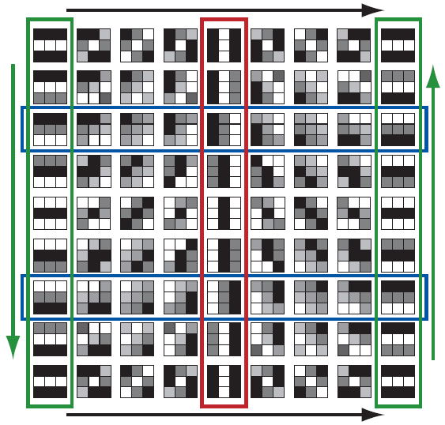
Where has persistent homology been used?
Image Processing
The space of 3x3 high-contrast patches from digital images has the topology of a Klein bottle.
Gunnar Carlsson, Tigran Ishkhanov, Vin de Silva, Afra Zomorodian. “On the Local Behavior of Spaces of Natural Images.” Journal of Computer Vision. Vol. 76, No. 1, 2008, p. 1 – 12.
Image credit: Robert Ghrist. “Barcodes: The Persistent Topology of Data.” Bulletin of the American Mathematical Society. Vol. 45, no. 1, 2008, p. 61-75.

Slide 24
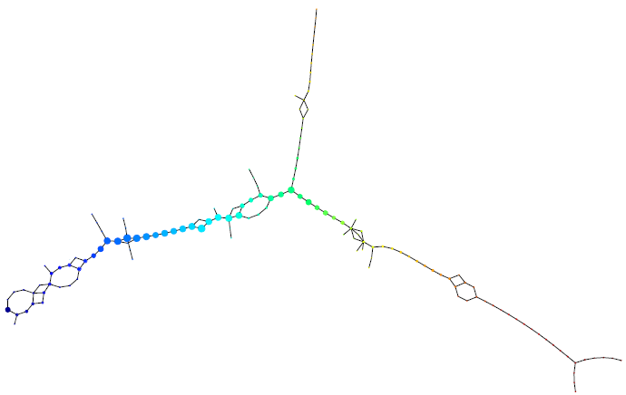
Where has persistent homology been used?
Cancer Research
Topological analysis of very high-dimensional breast cancer data can distinguish between different types of cancer.
Monica Nicolau, Arnold J. Levine, Gunnar Carlsson. “Topology-Based Data Analysis Identifies a Subgroup of Breast Cancers With a Unique Mutational Profile and Excellent Survival.” Proceedings of the National Academy of Sciences. Vol. 108, No. 17, 2011, p. 7265 – 7270.

Slide 25
Problem: Persistent homology is sensitive to outliers.

Slide 26
Problem: Persistent homology is sensitive to outliers.
Red points in dense regions
Purple points in sparse regions
Do we have to threshold by density?

Slide 27
Multi-dimensional persistence: Allows us to work with data indexed by two parameters, such as distance and density.
We obtain a bifiltration: a set of simplicial complexes indexed by two parameters.
$$↪$$
$$↪$$
$$↪$$
distance
$$↪$$
density

Slide 28
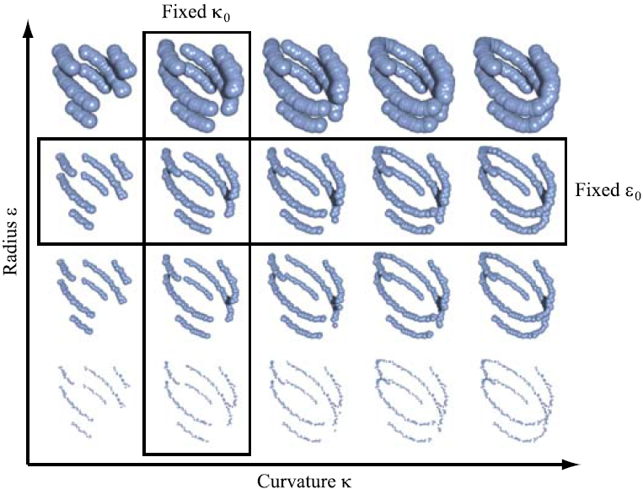
Example: A bifiltration indexed by curvature $κ$ and radius $ε$.
fixed $κ_{0}$
fixed $ε_{0}$
radius $ε$
Carlsson and Zomorodian (2009)
curvature $κ$
Ordinary persistence requires fixing either $κ$ or $ε$.

Slide 29
Algebraic Structure of Multi-dimensional Persistence
The homology of a bifiltered simplicial complex is a finitely-generated bigraded module: i.e. a 2-graded module over $F[x,y]$ for a field $F$.
We call this a 2-dimensional persistence module.
Problem: The structure of multi-graded modules is much more complicated than that of graded modules.
There is no complete, discrete invariant for multi-dimensional persistence modules (Carlsson and Zomorodian, 2007).
Thus, there is no multi-dimensional barcode.
Question: How can we visualize multi-dimensional persistence?

Slide 30
Concept: Visualize a barcode along any one-dimensional slice of a multi-dimensional parameter space.
Example:
Along any one-dimensional slice, a barcode exists.
distance
density

Slide 31
Bi-graded Betti numbers $ξ_{0}$ and $ξ_{1}$
Example: 1st homology (holes)
These are functions,
$$ξ_{0}, ξ_{1} : ℕ^{2}→ℕ$$
$$ξ_{0}\left(1,3\right)=1$$
$ξ_{0}$ indicates coordinates at which homology appears
$$3$$
$$2$$
$$1$$
$$1$$
$$2$$
$$3$$

Slide 32
Bi-graded Betti numbers $ξ_{0}$ and $ξ_{1}$
Example: 1st homology (holes)
These are functions,
$$ξ_{0}, ξ_{1} : ℕ^{2}→ℕ$$
$ξ_{0}$ indicates coordinates at which homology appears
$$3$$
$$2$$
$$1$$
$$ξ_{0}\left(2,1\right)=1$$
$$1$$
$$2$$
$$3$$

Slide 33
Bi-graded Betti numbers $ξ_{0}$ and $ξ_{1}$
Example: 1st homology (holes)
These are functions,
$$ξ_{0}, ξ_{1} : ℕ^{2}→ℕ$$
$$1$$
$$0$$
$$0$$
$ξ_{0}$ indicates coordinates at which homology appears
$$3$$
$$0$$
$$0$$
$$0$$
$$2$$
values of $ξ_{0}$ in green
$$0$$
$$1$$
$$0$$
$$1$$
$$1$$
$$2$$
$$3$$

Slide 34
Bi-graded Betti numbers $ξ_{0}$ and $ξ_{1}$
Example: 1st homology (holes)
These are functions,
$$ξ_{0}, ξ_{1} : ℕ^{2}→ℕ$$
$$ξ_{1}\left(2,3\right)=1$$
$ξ_{0}$ indicates coordinates at which homology appears
$$3$$
$$2$$
$ξ_{1}$ indicates coordinates at which homology disappears
$$1$$
$$1$$
$$2$$
$$3$$

Slide 35
Bi-graded Betti numbers $ξ_{0}$ and $ξ_{1}$
Example: 1st homology (holes)
These are functions,
$$ξ_{0}, ξ_{1} : ℕ^{2}→ℕ$$
$$ξ_{1}\left(3,3\right)=1$$
$ξ_{0}$ indicates coordinates at which homology appears
$$3$$
$$2$$
$ξ_{1}$ indicates coordinates at which homology disappears
$$1$$
$$1$$
$$2$$
$$3$$

Slide 36
Bi-graded Betti numbers $ξ_{0}$ and $ξ_{1}$
Example: 1st homology (holes)
These are functions,
$$ξ_{0}, ξ_{1} : ℕ^{2}→ℕ$$
$$0$$
$$1$$
$$1$$
$ξ_{0}$ indicates coordinates at which homology appears
$$3$$
$$0$$
$$0$$
$$0$$
$$2$$
$ξ_{1}$ indicates coordinates at which homology disappears
$$0$$
$$0$$
$$0$$
$$1$$
values of $ξ_{1}$ in red
$$1$$
$$2$$
$$3$$

Slide 37
R
I
V
E
T
ank
nvariant
isualization and
xploration
ool
Mike Lesnick
and
Matthew Wright

Slide 38
How RIVET Works
RIVET pre-computes a relatively small number of discrete barcodes, from which it draws barcodes in real-time.
Endpoints of bars appear in the same order in each of these two barcodes.
Endpoints of bars in this barcode have a different order.

Slide 39
Endpoints of bars are the projections of support points of the bigraded Betti numbers onto the slice line.
We can identify lines for which these projections agree.

Slide 40
Data Structure
point-line duality:
$$\left(a,b\right) ↔y=ax−b$$
At the core of RIVET is a line arrangement.
Each line corresponds to a point where projections of two support points agree.
Cells correspond to families of lines with the same discrete barcode.
When the user selects a slice line, the appropriate cell is found, and its discrete barcode is re-scaled and displayed.

Slide 41
bifiltration
compute Betti numbers $ξ_{0}$ and $ξ_{1}$
computational
pipeline
build line arrangement
compute discrete barcodes
ready for interactivity

Slide 42
Performance
Suppose we are interested in $i$^{th} homology.
Let $n$ be the total number of simplices of dimensions $i−1$, $i$, and $i+1$ in the bifiltration.
Let $k$ be the number of multigrades.
Then the time required to compute the line arrangement and all discrete barcodes is
$$O\left(k^{2}\log{k}+nk^{2}+n^{3}\right).$$
Then the time required to find a cell is $O\left(\log{k}\right)$.

Slide 43
For more information:
Robert Ghrist. “Barcodes: The Persistent Topology of Data.” Bulletin of the American Mathematical Society. Vol. 45, no. 1, 2008, p. 61-75.
Gunnar Carlsson and Afra Zomorodian. “The Theory of Multidimensional Persistence.” Discrete and Computational Geometry. Vol. 42, 2009, p. 71-93.
Michael Lesnick and Matthew Wright. “Efficient Representation and Visualization of 2-D Persistent Homology.” in preparation.

