Slide 2
Grant Budget Reporting
BMC – Grant Budget vs Actuals, by Object Class

Slide 3
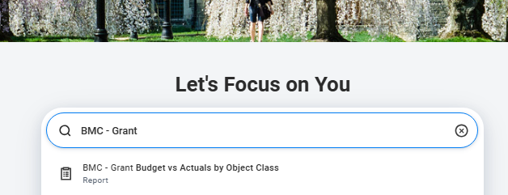
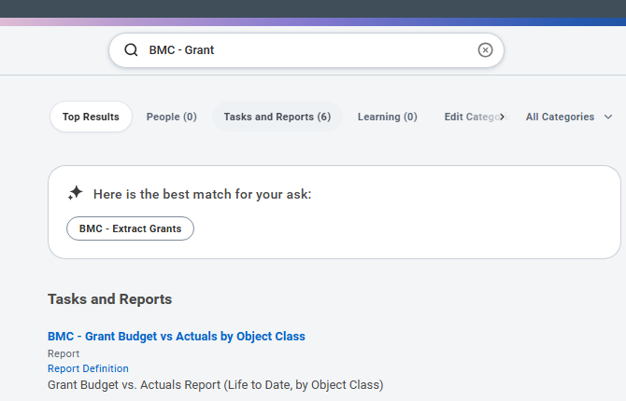
Report Navigation
Use the Search Bar on your Home page to locate reports in Workday
Type the name (or part of the name) of the report and suggested results will appear. You can click on the Report from the results
If you hit enter after typing in the search bar, you will be taken to a new screen that will provides you a categorized grouping of search results.

Slide 4
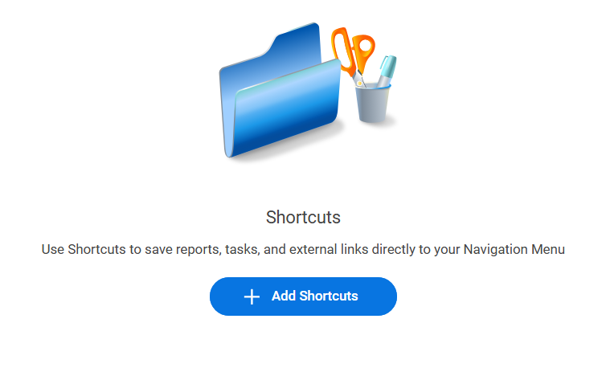
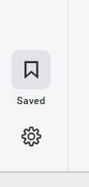
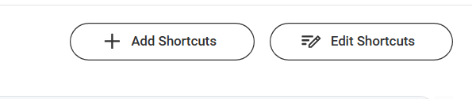
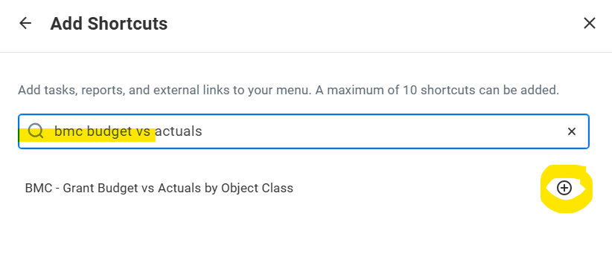
Bookmark Reports
You can save Reports instead of using the Search Bar
Use the “Saved” icon to manage and add shortcuts
Click the “Add Shortcuts” button
Search for the name of the report in the provided box
Click the “plus sign” button next to the desired option – it will then turn into a blue check box
Hit the “Add Shortcut” button
Hit “Save Changes”
Once you have saved choices, you can use the “Edit Shortcuts” button to update or remove shortcuts

Slide 5
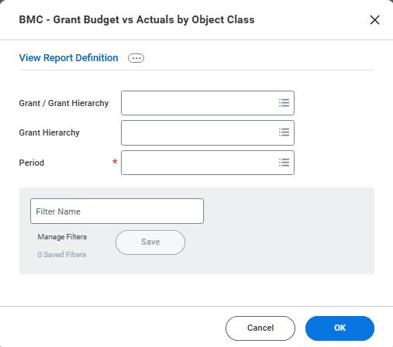
Report Prompts
Grant/Grant Hierarchy - Type in the name of a Grant or use the drop-down menu to find “All Grants” and pick from the list provided
Grant Hierarchy – Choose “All Grants” to see one report of combined activity in all your Grants
Period – Fiscal Year as of specific Month End
*some of the Grant Hierarchy options will not provide selectable values or may produce an error message.

Slide 6
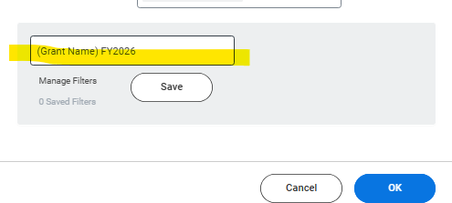
Saving a Report Prompt Filter
Once you enter the desired prompt choices, you can save a report filter to auto populate values the next time you run a report.
Create a “Filter Name” and then hit the “Save” button
You must do this BEFORE you hit the “OK” button
For example, if you chose a “Period” prompt value for May, you could save a prompt filter for each Fiscal year that will always provide the year-to-date expenses by fiscal year and the selected Grant.
To edit or delete a report filter, click the link “Manage Filters” link, to the left of the “Save” button

Slide 7
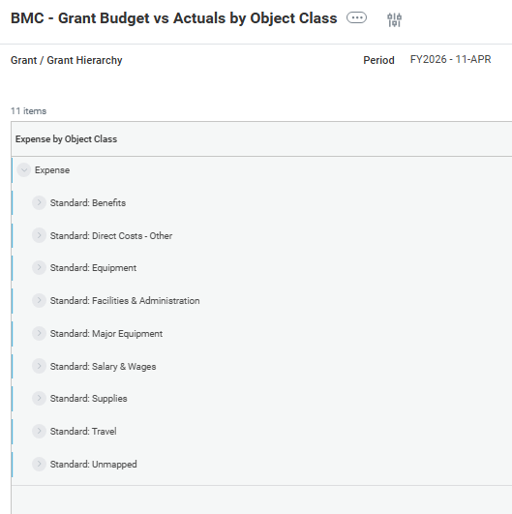
Budget Report Rows
Total Expense for the Grant(s) selected in the prompt
Object Class – Category of Expense
Use the Drop down arrow next to an Object Class to display a breakdown by Ledger Account
To see specific spending categories, use the drop down menu next to a Ledger Account to view Spend Categories.
*Many of the Financial Edge transactions converted as Standard: Unmapped Object Class
**We are working with the reporting team to display Revenue.

Slide 8
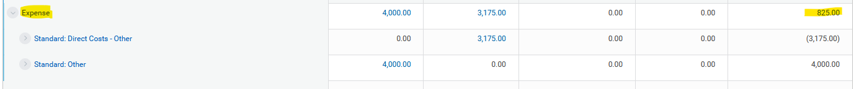
Budget Report Rows
Total Expense line will provide the overall balance for most grants
External, multiyear grants will not have the full budget in the first column
You can role up the lines, for simplification
Blue text is “clickable” for more details

Slide 9
Budget Report Columns
Budget – Planned amount for the Year
Actuals – Posted and processed Supplier Invoices, Expense Reports, Ad Hoc Payments, Payroll, and Manual Journal Entries
Pre-Encumbrance – Purchase Requisitions prior to approval and/or Purchase Order issuance
Encumbrance – Purchase Orders that are not fully received and/or invoiced
Remaining Balance – Subtraction of Budget and total Pre-Encumbered, Encumbered, and Actual Expenses

Slide 10
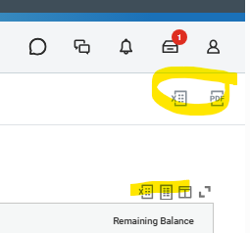
Exporting Functionality
If you want to export a high-level budget report, use the Excel or PDF Icons located on the top, right of your screen.
The PDF and Excel option will only provide the highest level of information, which is total Expense and Totals by Object Class. It will not provide the capability to view by Ledger Account or Spend Category.

Slide 11
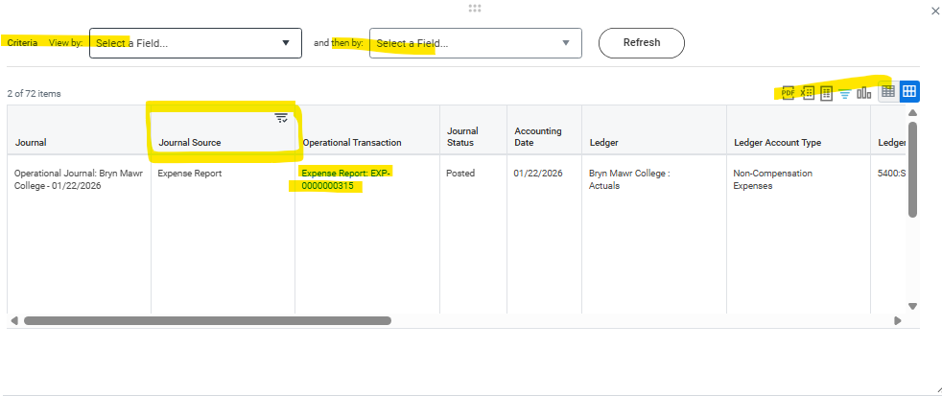
Workday Matrix Reports – Query for Specific Details
Workday provides reports within reports to allow for queries of specific data.
Any number that is blue (or red) can be clicked on to provide a new report of detailed information relating to the chosen number.
A pop-up report will display and can be used to:
Refresh details by selection of View By Criteria
  “View by” will display as rows
  “and then by” will display as columns
Export to PDF, Excel, Worksheets, or View as a Graph
Filter by column headings (such as Journal Source)
Click on links for Operational transactions to view specific details

Slide 12
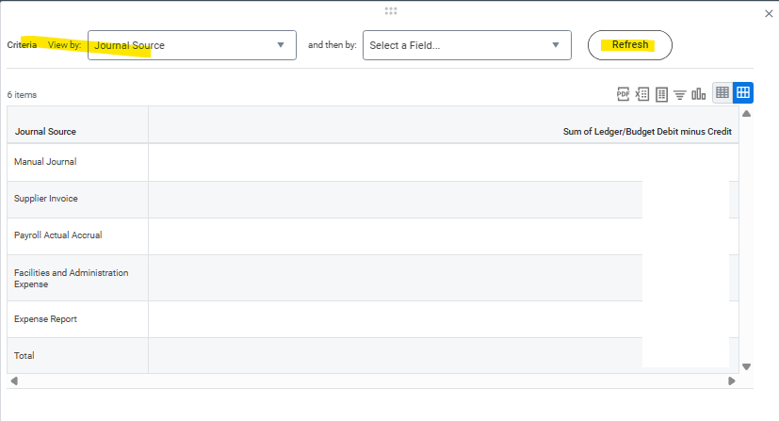
Journal Sources
Manual Journals are journal entries posted by Accounting. The majority will represent converted entries from Financial Edge. Manual Journals may also be needed to post transfers between departments or corrections of accounting entries.
Operational Journals are journal entries posted by Workday delivered Processes, such as Payroll, Purchasing, Supplier Invoices and Expense Reports.
Organizing your Actual Expenses by Journal Source can help you quickly identify transactions and understand how spending is occurring in your department.

Slide 13
Other Notes
External and Internal Grants can be reviewed in this report.
For External Grants, the remaining balances may not be fully accurate since this report only displays the fiscal year transactions and one year of Award Budget. It does not contain the full history of the Award.
You can still access Financial Edge or Bionic for historical information.
Department Academic Administrative Assistants do not have access to this Budget report in Workday.
They can view internally funded Grants with the report BMC - Internal Grant Spendable Balances - Cost Center Analyst. If discrepancies between these two reports are noticed, please follow up with the Office of Sponsored Research.
Grant Worktags are associated to Department Cost Centers in Workday which allows AAAs to view Internal Grants by Cost Center.

Slide 14
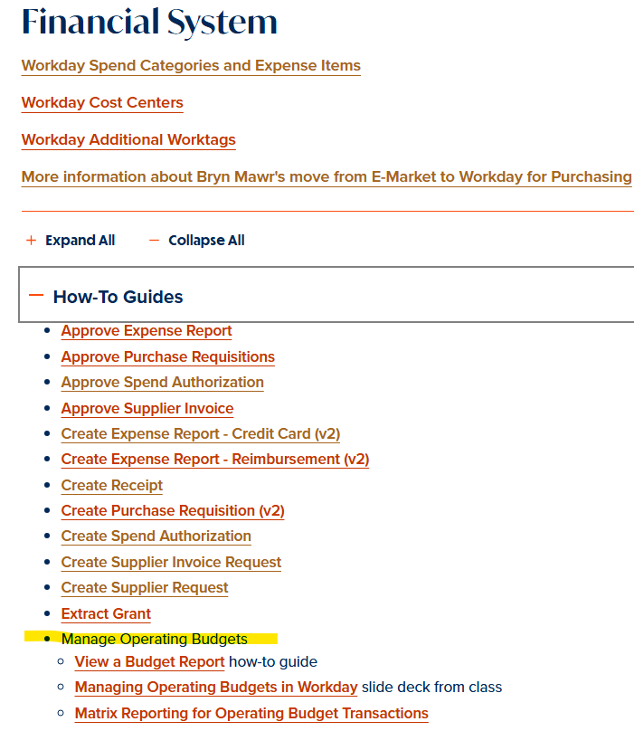
Workday How-to-Guides
Guides and Videos can be found under the Financial Systems section
Workday at Bryn Mawr

Slide 15
Accounting Adjustments
If you are reviewing your budgets, both Grant and Operational, and find an entry that was incorrectly posted, please follow the process provided on the Finance and Administration website.
Workday allows any user to select any Worktag on a Purchase requisition, Supplier Invoice, and Employee Expense Report.
The Workday Approval process is important part of ensuring that only accurately coded transactions are approved.
Accounting Adjustments should be requested when purchases were incorrectly charged or are missing a Worktag
Spend Categories and Expense Items should be selected in representation of what was purchased; not to match a particular budget line.
When purchases are correctly categorized, the budget report will display the actual spending trends of the department and facilitate planning for future years.

Slide 16
Contact
Sarah Robertson
Director of Sponsored Research
Phone: 610.526.5496
serobertso@brynmawr.edu

Slide 17
Contact
Patricia Szybowksi
Assistant Controller for Disbursements
Phone: 610.526.5262
pszybowski@brynmawr.edu

