Slide 1
Notes:
This slide can be used at the very start of your presentation deck.
Click on the icon to add your own photo to the architectural frame.

Slide 2
Budget Reporting
BMC – Budget vs Actuals - Manager
Notes:
This slide can be used to introduce the main subject matter of your presentation, along with a subtitle.
Update the text on the slide.

Slide 3
Budget Best Practices
Workday allows any user to select any Worktag on a Purchase requisition, Supplier Invoice, and Employee Expense Report.
Cost Center Managers should review transactions for accuracy prior to approval.
Cost Center Managers and Cost Center Analysts should use the budget report to review encumbered and posted transactions to ensure they are accurately charged. Accounting Adjustments should be requested when purchases were incorrectly charged to the Cost Center or are missing a Worktag, like Activity or Gift.
Spend Categories and Expense Items should be selected in representation of what was purchased; not to match a particular budget line.
When purchases are correctly categorized, the budget report will display the actual spending trends of the department and facilitate planning for future years.

Slide 4
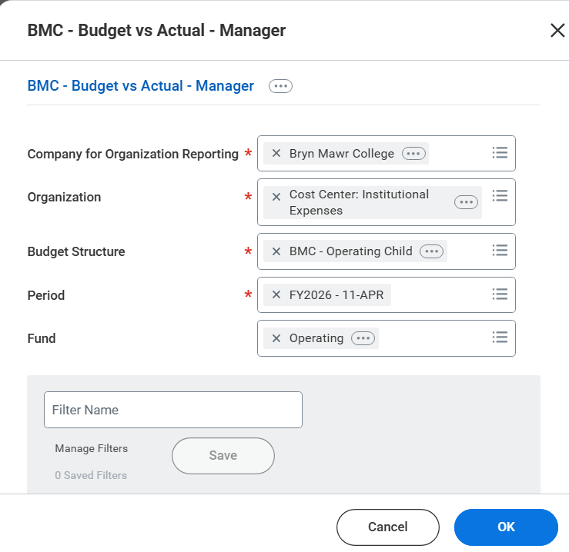
Budget Report Prompts
Company - Bryn Mawr College
Organization – Cost Center (Department)
Budget Structure – BMC Operating Child
Period – Fiscal Year as of specific Month End
Fund – Operating
*We are working with the reporting team to simply the prompt choices and allow for other organization types (like Activity) to be selected

Slide 5
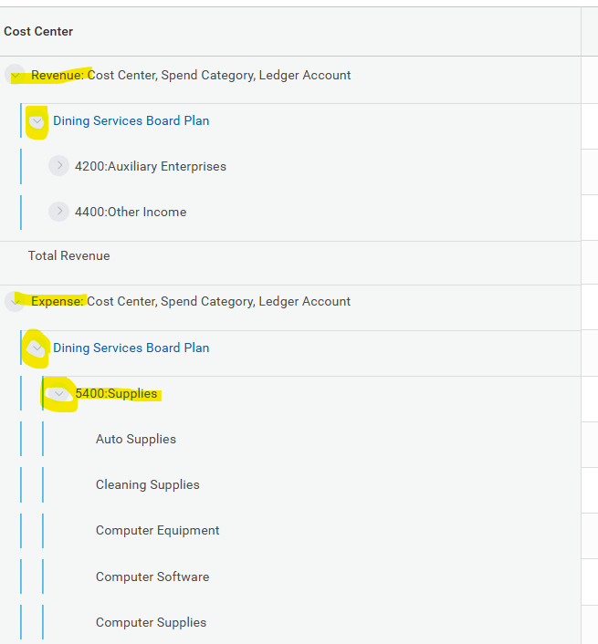
Budget Report Rows
Total Revenue and/or Expense Lines for the cost center(s) selected in the prompt
Use the Drop down arrow to display a breakdown by Ledger Account
To see specific categories of spending, use the drop down menu next to a Ledger Account to view Spend Categories.
Grand Total – Net Revenue and Expense
*We are working with the reporting team to display Revenue Category breakdown
Notes:
Update the text on the slide.
To add bullets, use the Format dropdown > Bullets & Numbering.

Slide 6
Budget Report Columns
Budget – Planned amount
Pre-Encumbrance – Purchase Requisitions prior to approval and/or Purchase Order issuance
Encumbrance – Purchase Orders that are not fully received and/or invoiced
Actuals – Generated or received Revenue, posted and processed Supplier Invoices, Expense Reports, Ad Hoc Payments, Payroll Accruals, and Manual Journal Entries
Total Spent – Addition of Pre-Encumbered, Encumbered, and Actual Expenses
Remaining Budget – Subtraction of Budget and Total Spent
% Left of Budget – Percentage of Total Spent over the Budget for this line
*Working with reporting team to adjust Actuals representation to display “reserved” entries, like unpaid expenses reports, and to remove entries related to “Business Assets”.

Slide 7
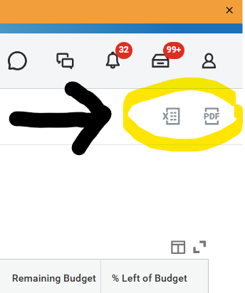
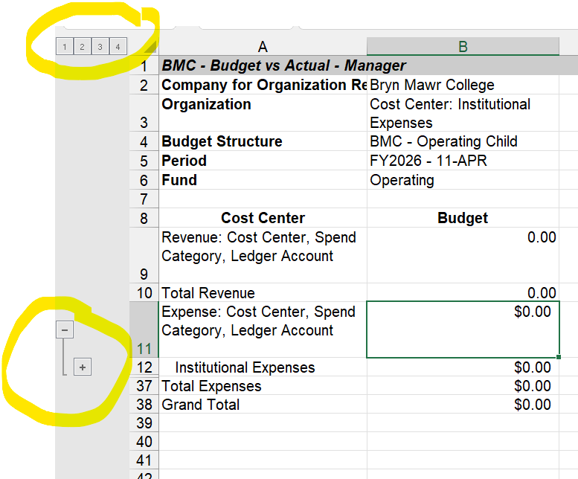
Exporting Functionality
If you want to export a high-level budget report, use the Excel or PDF Icons located on the top, right of your screen.
The PDF option will only provide the highest level of information, which is total Revenue and Total Expense. It will not provide the capability to view by Ledger Account or Spend Category.
The Excel option will provide a Subtotaled Outline of the summarized details by Ledger Account and Spend Category. Use the Outline Numbers or Plus Sign buttons on the left side of the worksheet to expand the outline and view details by Ledger Account down to Spend.

Slide 8
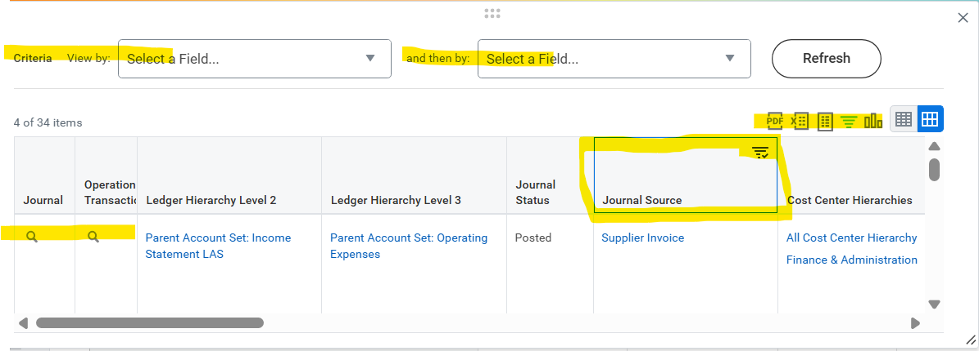
Workday Matrix Reports – Query for Specific Details
Workday provides reports within reports to allow for queries of specific data.
Any number that is blue (or red) can be clicked on to provide a new report of detailed information relating to the chosen number.
A pop-up report will display and can be used to:
Refresh details by selection of View By Criteria
  “View by” will display as rows
  “and then by” will display as columns
Export to PDF, Excel, Worksheets, or View as a Graph
Filter by column headings (such as Journal Source)
Click on magnifying glass to view details of transactions
Notes:
Update the text on the slide.
To add bullets, use the Format dropdown > Bullets & Numbering.

Slide 9
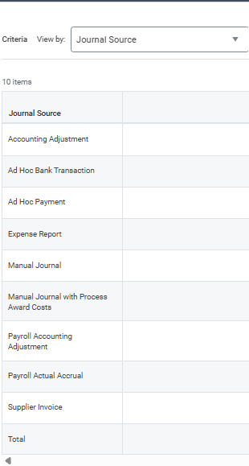
Journal Sources
Manual Journals are journal entries posted by Accounting. The majority will represent converted entries from Financial Edge. Manual Journals may also be needed to post transfers between departments or corrections of accounting entries.
Operational Journals are journal entries posted by Workday delivered Processes, such as Payroll, Purchasing, Supplier Invoices and Expense Reports.
Organizing your Actual Expenses by Journal Source can help you quickly identify transactions and understand how spending is occurring in your department.
Notes:
Update the text on the slide.
To add bullets, use the Format dropdown > Bullets & Numbering.

Slide 10
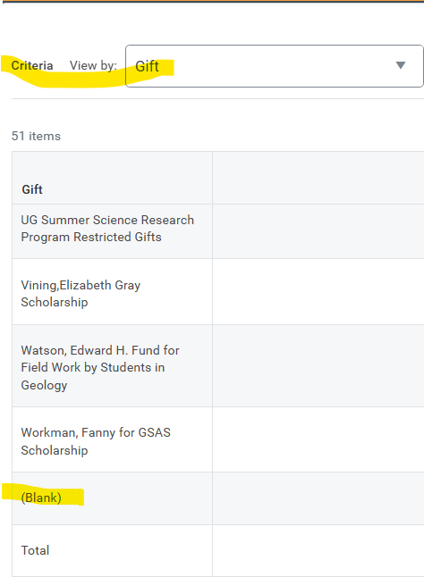
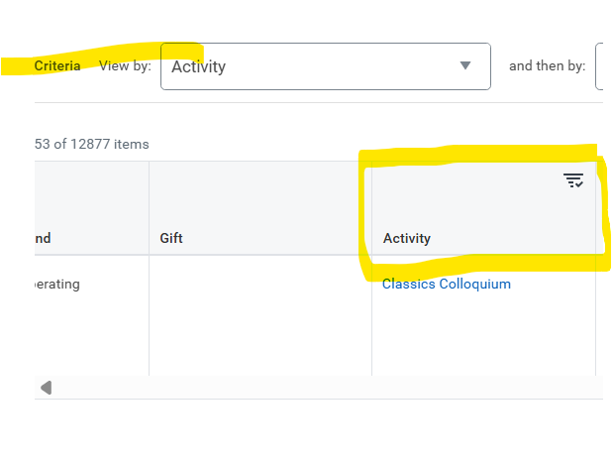
Activity and Gift Worktags in Operating Budget
Activity Worktags are used to track operational projects within a Cost Center. Filter by the Activity column or use the Criteria to obtain a summarized listing of Activity spending.
Expenses coded to a Gift Worktag will appear in the operational budget report. Using the pop-up report to filter by Gifts will help you exclude this amount from your operational spending.
The (Blank) row will provide a total not charged to a Gift.
Notes:
Update the text on the slide.
To add bullets, use the Format dropdown > Bullets & Numbering.

Slide 11
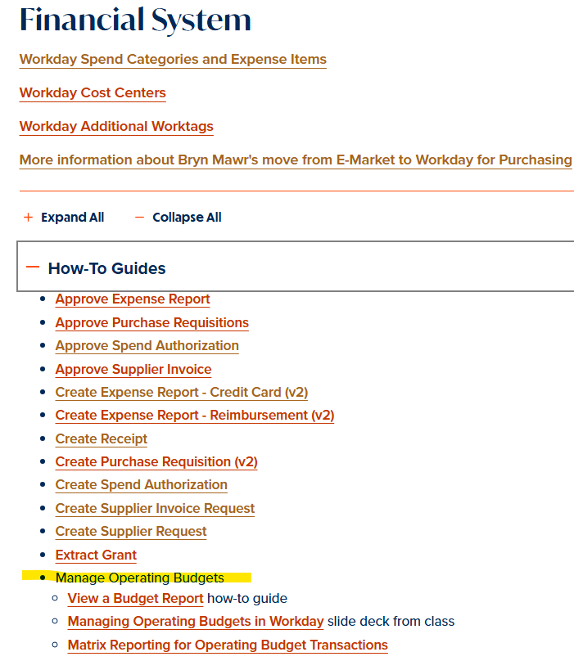
Workday How-to-Guides
Guides and Videos can be found under the Financial Systems section
Workday at Bryn Mawr

Slide 12
Additional Help
For specific questions about the budget report or to request a report on Roll Forwards or Gifts please email:
controllersoffice@brynmawr.edu
Next week’s workshop will be on Grant reporting:
Grants Budget Reporting
Monday 4/20/2026, 10am
Collier 310

Slide 13
Contact
Michael Chaplinski
Budget Manager
Phone: 610.526.5664
mchaplinsk@brynmawr.edu
Notes:
Use the text boxes to update your contact information.

Slide 14
Contact
Tijana Stefanovic
Interim Vice President, Finance
Phone: 610.526.5632
tstefano@brynmawr.edu
Notes:
Use the text boxes to update your contact information.

Slide 15
Contact
Patricia Szybowksi
Assistant Controller for Disbursements
Phone: 610.526.5262
pszybowski@brynmawr.edu
Notes:
Use the text boxes to update your contact information.

