Slide 1
Notes:
This slide can be used at the very start of your presentation deck.

Slide 2
Accounting Adjustments
Payroll, Supplier Invoices, Expense Reports, Ad Hoc Payments & Manual Journals
Notes:
This slide can be used to introduce the main subject matter of your presentation, along with a subtitle.
Update the text on the slide.

Slide 3
Identify Issues and Locate Documents
Use Workday reports to review accounting of both manual journals, typically from Financial Edge data conversion, and operational journals from Workday payrolls, requisitions, ad hoc payments, supplier invoices and expense reports.
BMC – Budget vs Actuals – Manager
  Encumbrances – Identify issues with requisitions or in-progress expense reports
  Actuals – Identify issues with posted journals, paid supplier invoices, and paid expense reports
Requisitions Dashboard
  Awaiting Action – these requisitions can be edited to update the accounting
  Completed – these requisitions must be fully received and invoiced before you can request an adjustment
My Supplier Invoice Requests
  Draft or In-Progress – these requests can be edited to update the accounting
  Approved – must request adjustment
Expense Hub or My Expense Reports
  Draft, Waiting or Approved - these reports can be edited to update the accounting
  Paid - must request adjustment
More detailed information posted to our Accounting Adjustments web page
Notes:
Update the text on the slide.
To add bullets, use the Format dropdown > Bullets & Numbering.

Slide 4
Budget Reporting
In-person training and Q&A session Monday, April 13th at 10:00AM
Collier 310
Register here
Notes:
Update the text on the slide.
To add bullets, use the Format dropdown > Bullets & Numbering.
The image on this slide is 1091x1125. To change the image on this slide:
Right-click on the image, and select “Format Background” from the menu.
From the Format Background sidebar click “Insert.”
Navigate to where your new image is located, and choose it to upload.
From the Format Background sidebar, use select the “Tile picture as texture” box.
Set the alignment to bottom right.
Use the X/Y Scale to fit the image to the slide (make sure the values are equal to avoid stretching)
Use the X Offset to align the image horizontally in the space.

Slide 5
Payroll Accounting
Update the payroll on the employee’s position before you request an adjustment to incorrect accounting
Supervisory Organization
  An employee’s default payroll costing is determined by the assigned Worktags on the Supervisory Organization
  Supervisory Organizations are only set up to charge a Cost Center Worktag
Costing Allocation
  Costing Allocations are necessary when you want to charge the employee’s payroll to an Activity, Grant, Gift, Project or Roll Forward Worktag.
Accounting adjustment requests require the following:
Reason for the adjustment
Employee’s Name
Pay Group
Employee’s position number
Pay Period(s)
Distribution – 100% or Splits
Worktags
Notes:
Update the text on the slide.
To add bullets, use the Format dropdown > Bullets & Numbering.

Slide 6
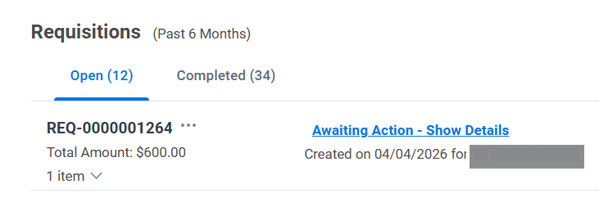
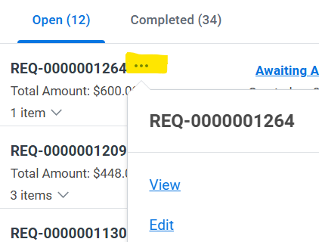
Requisition Editing – Awaiting Action or Draft
You can edit requisitions that are “Open” with a status of “Awaiting Action” or “Draft”
Find these in the Requisition Dashboard and use the “three dot” menu, next to the document number, to find a drop-down list of linked actions
Select the option to “Edit”
Make desired changes and then hit “Submit”
“Open” Requisitions with “Approved” status cannot be adjusted. Use the dashboard to track the status between “Ordered and Invoiced”

Slide 7
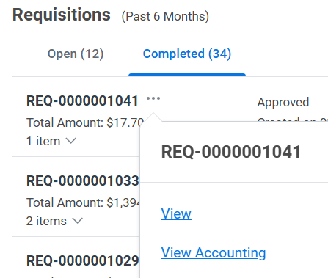
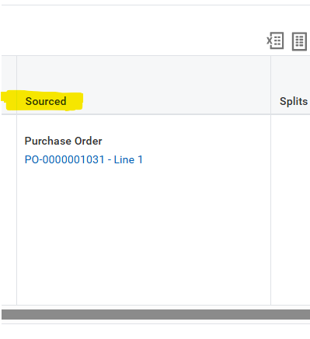
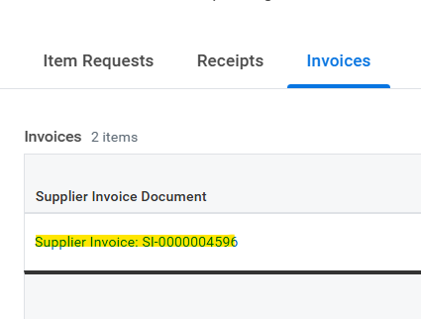
Requisition Adjustment - Completed
A Requisition becomes completed once it has been fully issued (sourced), received, and invoiced. In your dashboard, they will move to the “Completed” tab. You can locate the Supplier Invoice document number by:
Using the three-dot menu to “View” the Requisition
Scroll the Goods/Service line, to the far right, to find the “Sourced” Column and click on the Purchase Order Line
Scroll to the bottom of the Purchase Order line to find the Invoices tab

Slide 8
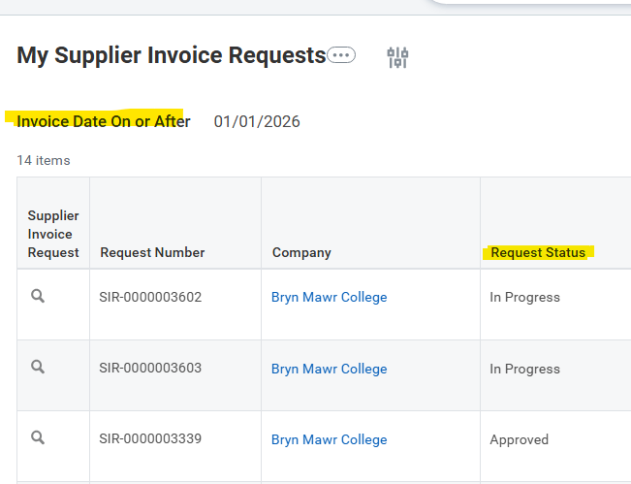
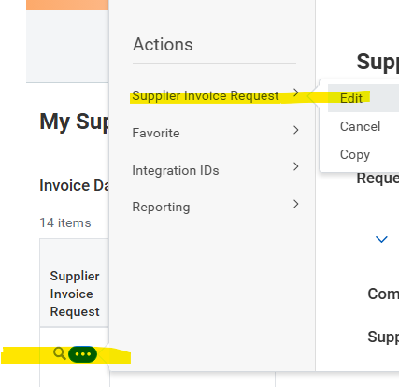
Supplier Invoice Request Editing – Draft or In Progress
My Supplier Invoice Requests is a report that will display requests that you have created. Be sure to update the Invoice Date prompt as it defaults to 30 days prior.
Requests with a status of “Draft” or “In Progress” can be edited
Draft – Use the related actions (blue button next to the magnifying glass) to “Edit” or “Cancel”
  Cancel only when this is a duplicate submission or it cannot be updated easily
In Progress – Use the related actions to “Edit”
  Editing will allow you to update the budget Worktags and send the invoice for approvals again

Slide 9
Supplier Invoice Requests - Approved
To request an accounting adjustment, you will need to provide the following:
Reason for the adjustment
Supplier Invoice Number – please provide the Workday assigned document number
Amount
Proposed Spend Categories
Proposed Travel Worktag (if needed) and the Country if Foreign
Budget Worktags and related distributions
Once an invoice request has been approved, you will only see the option to “Copy”. View the request by clicking on the magnifying glass.
If the incorrect combination of Worktags were used, you can request an accounting adjustment.
You can also check on the payment status of your request from opening the Supplier Invoice document number
Updated user guides have been linked on the Workday at Bryn Mawr How-to-Guide site

Slide 10
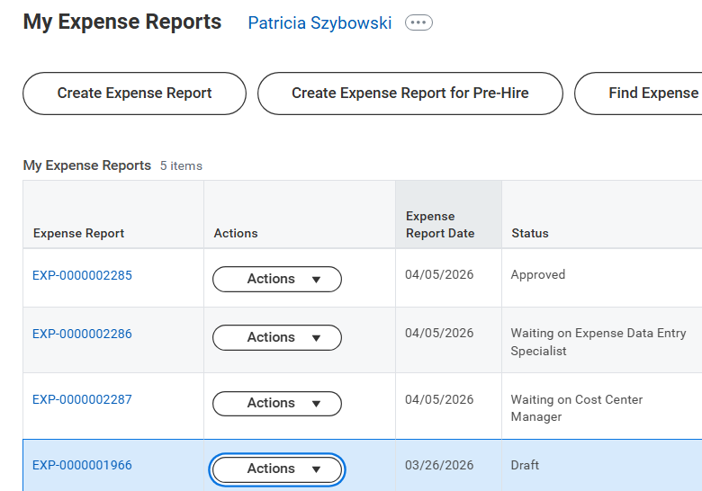
Expense Report Editing – Draft, Waiting, or Approved
A list of your expense reports can be found in the “Expense Hub” or by searching “My Expense Reports”.
Any status, other than “Paid” can be edited by the employee (or delegate). Approved reports display in the budget reports as “reserved” or “encumbered”
You will see an “Actions” button next to expense reports that can be updated:
Draft – Select “Edit” or “Cancel”
Approved and Waiting – Select “Change” or “Cancel
  Only Cancel when the report is too complicated to fix and you want to start over from scratch

Slide 11
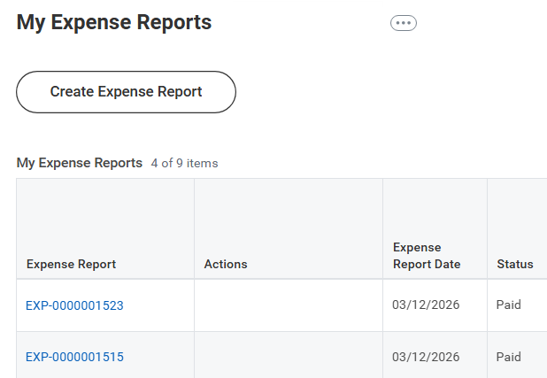
Expense Report - Paid
Expense reports with a status of Paid will need an accounting adjustment to update the budget Worktags.
Click on the Expense Report number to review the posted Worktags.
To request an accounting adjustment, you will need to provide the following:
Reason for the adjustment
Expense Report Number
Line of Expense Report
Amount
Proposed Expense Item
Proposed Travel Worktag (if needed) and the Country if Foreign
Budget Worktags and related distributions

Slide 12
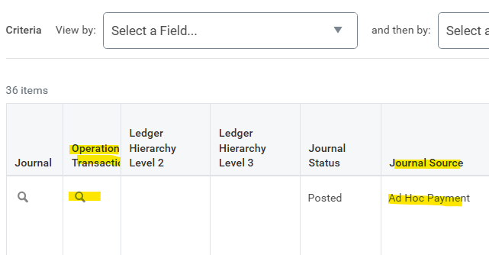
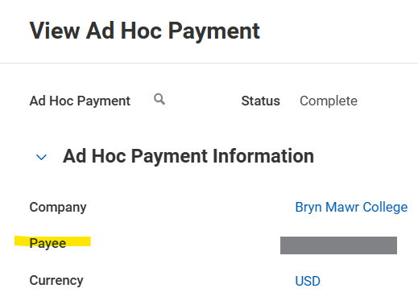
Ad Hoc Payments
“Ad Hoc Payments” are Operational Journals used in Workday to post Student, Trustee, or Alumnae/i related payments.
You can find these transactions by reviewing the BMC – Budget vs Actuals – Manager report.
From the report, click on an expense line “Actuals” figure and use the Pop-Up Matrix report to filter by “Journal Source”
You can click on the magnifying glass under “Operational Transaction” to navigate to “View Ad Hoc Payment”. The Payee and other details are listed on this page

Slide 13
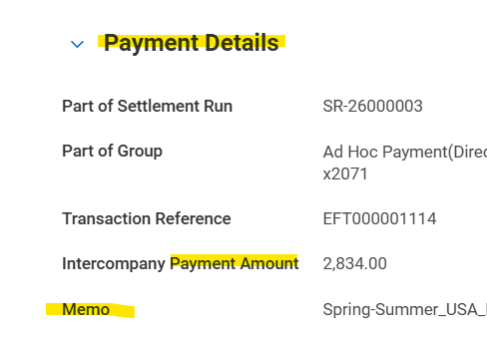
Ad Hoc Payment - Adjustments
To request an adjustment to an ad hoc payment , you will need the following:
Reason for Adjustment
Ad Hoc Payee Name
Payment Date
Payment Memo – copy from “View Ad Hoc Payment”
Payment Amount
Proposed Spend Category
Proposed Travel Worktag (if needed) and the Country if Foreign
Budget Worktags and related distributions

Slide 14
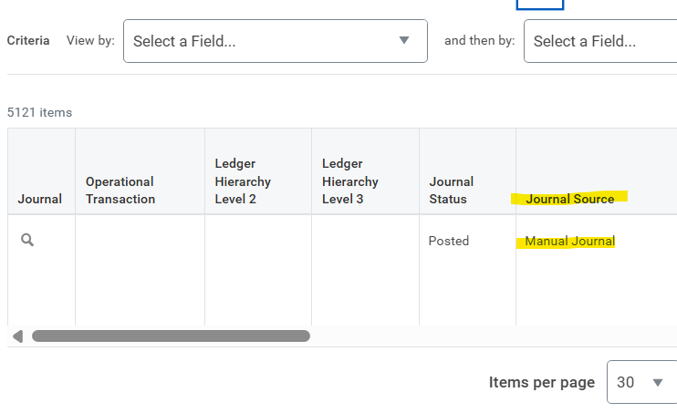
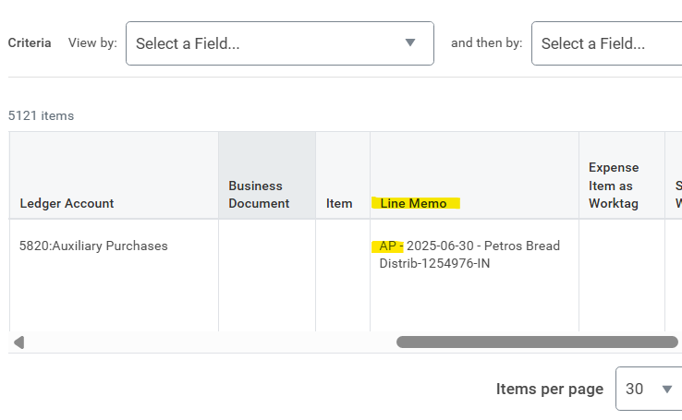
Manual Journals
“Manual Journals” in Workday were used to convert the Financial Edge transactions.
You can find these transactions by reviewing the BMC – Budget vs Actuals – Manager report.
From the report, click on an expense line “Actuals” figure and use the Pop-Up Matrix report to filter by “Journal Source”
The “Line Memo” field will provide some details from Financial Edge, such as the type of transaction, the reporting month, supplier, invoice number, or credit card merchant
AP – Accounts Payable
CC – Credit Card
PR – Payroll
You can still use Financial Edge to locate additional details or legacy account strings.

Slide 15
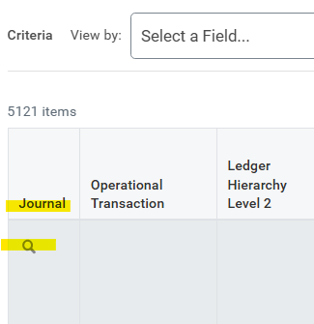
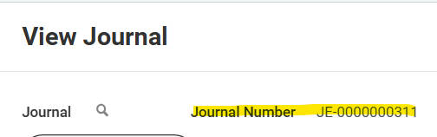
Manual Journals - Adjustments
To request an adjustment to a manual journal, you will need the following:
Reason for Adjustment
Journal Entry Number
Line Memo Details – copy from your budget report line
Amount
Proposed Spend Category
Proposed Travel Worktag (if needed) and the Country if Foreign
Budget Worktags and related distributions
To locate the Journal Entry Number, click on the magnifying glass to navigate to “View Journal”.
Journal Entry Numbers start with “JE-0”

Slide 16
Account Adjustment Request Form
An Excel spreadsheet form is linked to the Purchases and Payments Forms website.
The form contains a tab for each type of request.
Each tab represents one request. You will need to create a separate request when you have multiple, different, invoices or expense report lines to adjust.
A comments box is provided for additional details or when you are uncertain of, or cannot locate, budget Worktags.
Once completed, email the completed form to journalentries@brynmawr.edu
If you are not the Cost Center Manager, or Budgetary Worktag Manager, please cc the appropriate authorized person on your email request

Slide 17
Other Types of Journals
In February, revenue generating departments were provided with an Excel form to request transfers
The Provost office created a Qualtrics form to collect requests for inter-departmental cost sharing transfers
When you have a journal entry request that doesn’t align with the provided form/process options, please email journalentries@brynmawr.edu . Be sure to provide supporting documentation and ample details to understand your request.

Slide 18
Budget Reporting
In-person training and Q&A session Monday, April 13th at 10:00AM
Collier 310
Register here
Notes:
Update the text on the slide.
To add bullets, use the Format dropdown > Bullets & Numbering.
The image on this slide is 1091x1125. To change the image on this slide:
Right-click on the image, and select “Format Background” from the menu.
From the Format Background sidebar click “Insert.”
Navigate to where your new image is located, and choose it to upload.
From the Format Background sidebar, use select the “Tile picture as texture” box.
Set the alignment to bottom right.
Use the X/Y Scale to fit the image to the slide (make sure the values are equal to avoid stretching)
Use the X Offset to align the image horizontally in the space.

Slide 19
Contact
Patricia Szybowski
Assistant Controller for Disbursements
Phone: 610.526.5262
pszybowski@brynmawr.edu
Notes:
Use the text boxes to update your contact information.

